Slide 1
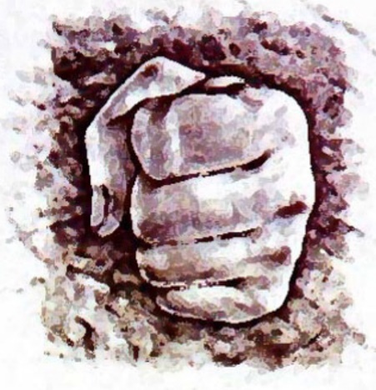
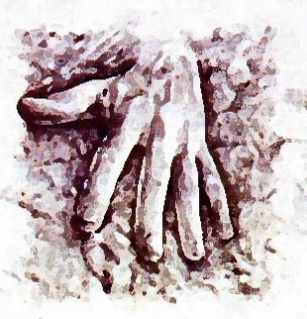
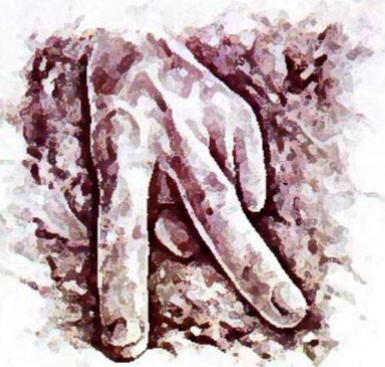
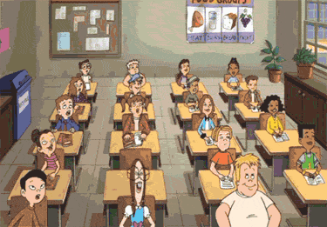
The Class Vs. The Computer R,P,S
Rock
Paper
Scissors

Slide 2
Let’s Practice…
Hold out one hand and play Rock, Paper, Scissors
Ready…

Slide 3
Let’s Practice…
The Computer is…
Scissors
Who won???
Who Lost???
Who Tied???

Slide 4
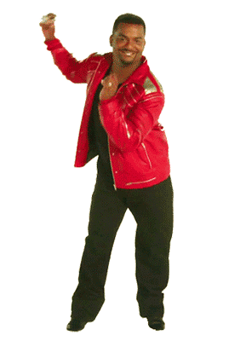
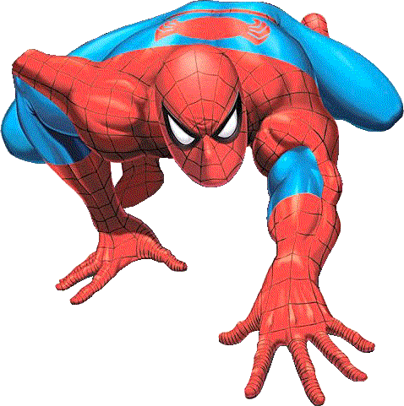
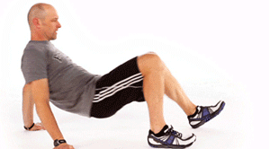
The Class Vs. The Computer R,P,S
The Computer is…
Paper
If You Won…
If You Lost…
If You Tied…
Dance For 30 Seconds
Spiderman Walk For 30 Seconds
Crab Walk For 30 Seconds

Slide 5
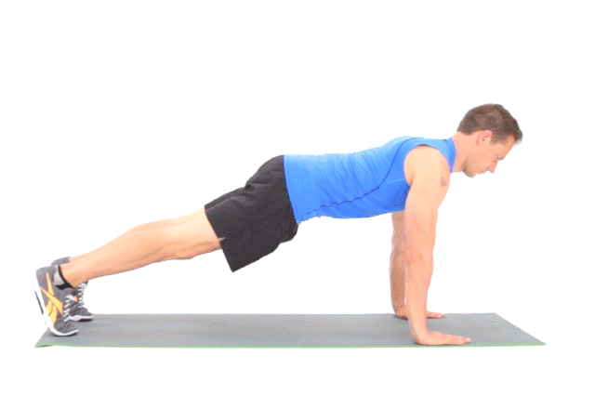
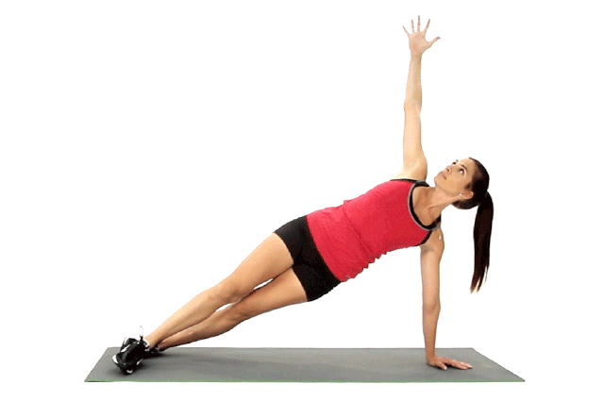
The Class Vs. The Computer R,P,S
The Computer is…
Scissors
If You Won…
If You Lost…
If You Tied…
Jog Victory Laps For 30 Seconds
Do Pushups For 30 Seconds
Hold This Position For 30 Seconds

Slide 6
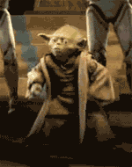
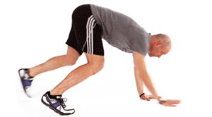
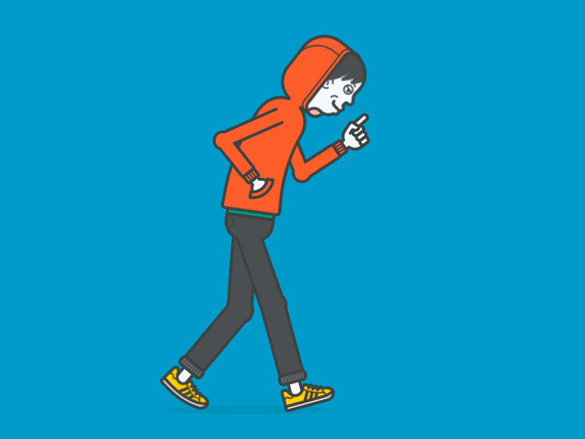
The Class Vs. The Computer R,P,S
The Computer is…
Rock
If You Won…
If You Lost…
If You Tied…
Yoda Dance For 30 Seconds
Bear Crawl For 30 Seconds
Walk Like This For 30 Seconds

Slide 7
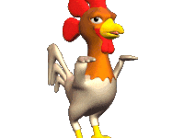
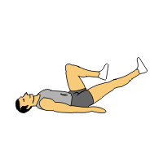
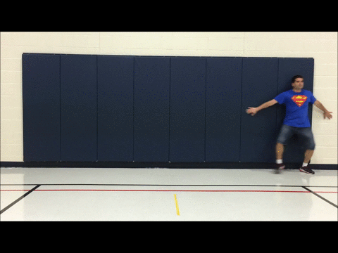
The Class Vs. The Computer R,P,S
The Computer is…
Scissors
If You Won…
If You Lost…
If You Tied…
Do The Chicken Dance For 30 Seconds
Bicycle On Back For 30 Seconds
Batman Along One Wall For 30 Seconds

Slide 8
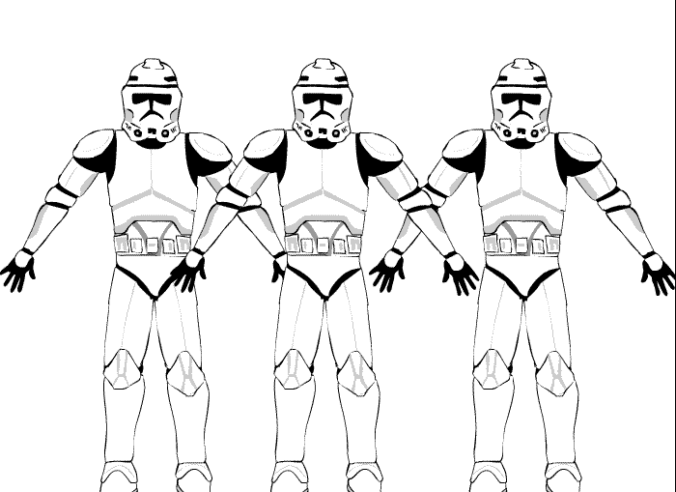
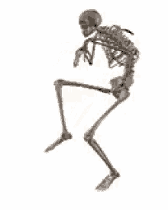
The Class Vs. The Computer R,P,S
The Computer is…
Paper
If You Won…
If You Lost…
If You Tied…
Shake Hands Of Others Who Won For 30 Seconds
Dance The Macarena For 30 Seconds
Tiptoe For 30 Seconds

Slide 9
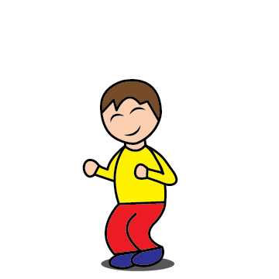
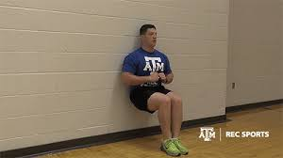
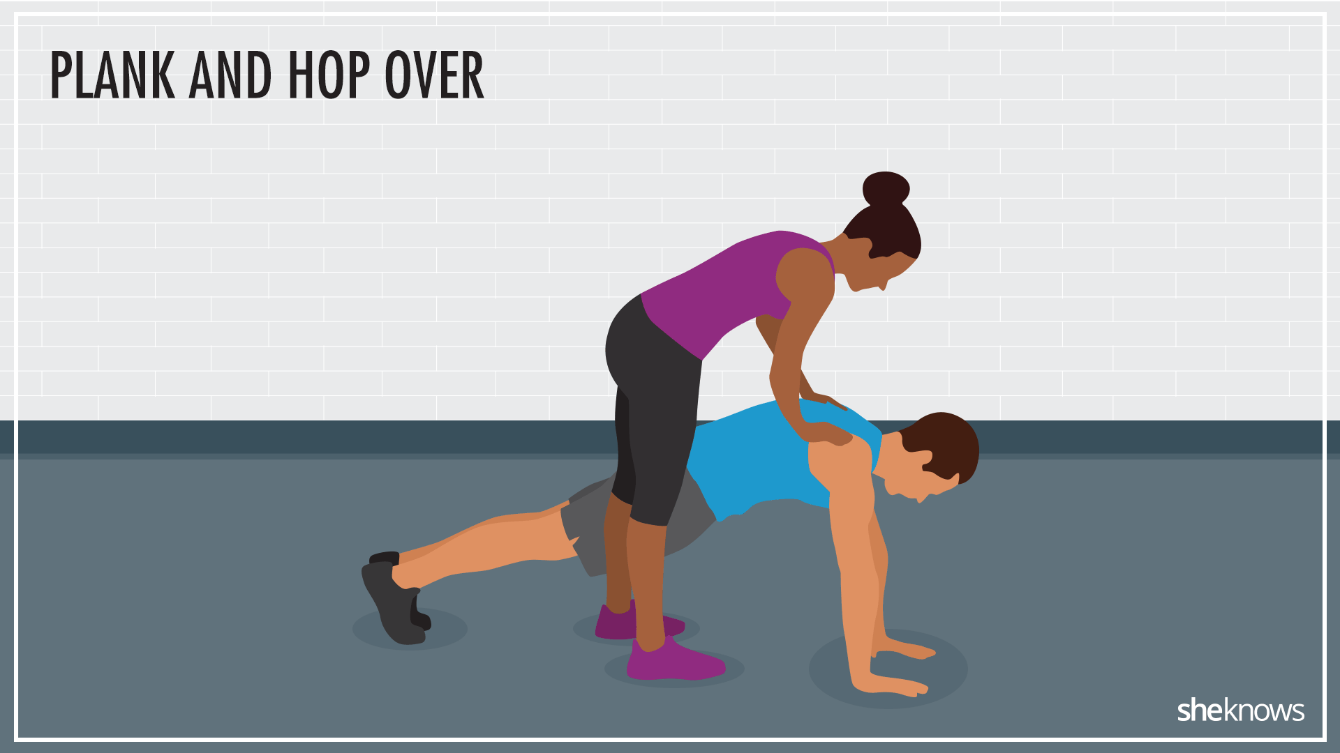
The Class Vs. The Computer R,P,S
The Computer is…
Rock
If You Won…
If You Lost…
If You Tied…
Wall Sit For 30 Seconds
Jump And Say “I Love PE!” For 30 Seconds
Do This With Someone Else Who Tied For 30 Seconds

